Slide 1
Encoding Provenance Metadata for Social Science Datasets
Carl Lagoze
University of Michigan School of Information
Jeremy Williams
Cornell Institute Social and Economic Research, Cornell University
Lars Vilhuber
Labor Dynamics Institute, Cornell University
Cornell NSF Census Research Network (NCRN)

Slide 2
Motivation: Replicating of research results
Replication of methods, data inputs, computational environment is a critical element of the scientific approach
Various stakeholders in science including journals, funding agencies (in the US), learned societies have been moving to make archiving of inputs to scientific results more robust, even mandatory

Slide 3
Problem: increased use of restricted-access data

Slide 4
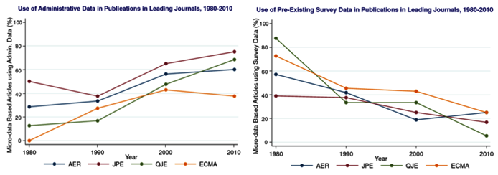
Increasing number of scholars pursuing research programs that mandate inherently identifiable data (e.g., geospatial relations, exact genome data, etc.)

Slide 5
Problem is not limited to economics and social science
Many of the emerging “big data” applications come from private sources that are inaccessible to other researchers. The data source may be hidden, compounding problems of verification, as well as concerns about the generality of the results.
Huberman, Nature 482, 308 (16th February 2012)

Slide 6
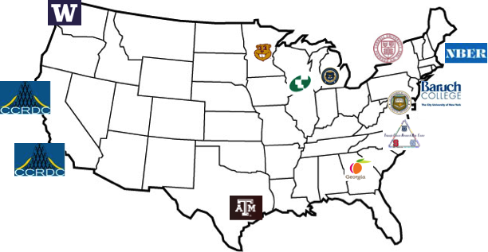
These researchers acquire authorized, generally unfettered, restricted access to the confidential, identifiable data and perform their analyses in secure environments

Slide 7
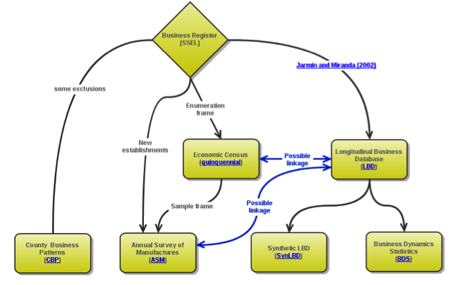
LBD provenance and related data
Restricted access data in the provenance chain complicates the curation and knowledge discovery process

Slide 8
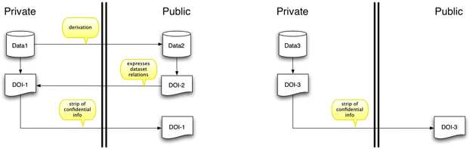
Metadata and data, inside and outside the firewall

Slide 9
Summary of problem
Inadequate curation of secure data sets
Inconsistent or nonexistent identification
Need for selective hiding of data & metadata

Slide 10
Comprehensive Extensible Data Documentation and Access Repository (CED²AR)
Collect and standardize disparate metadata into a single DDI repository
Provide a web interface for researchers to access
Build an API for developers to use
Use open standards
Enhanced metadata with cloaking and relationship information

Slide 11
Entity/Identifier Strategy
DOI’s – EZID
Use-case driven entity definition – metadata level rather than file level
Opaque DOI - e.g., versions
doi:10.5072/FK2M327JW - doi:10.5072/GR2M11PT
NOT: doi:10.5072/FK2M327JW/V1 - doi:10.5072/FK2M327JW/V2

Slide 12
Metadata cloaking requirements
Variable level
Value level

Slide 13
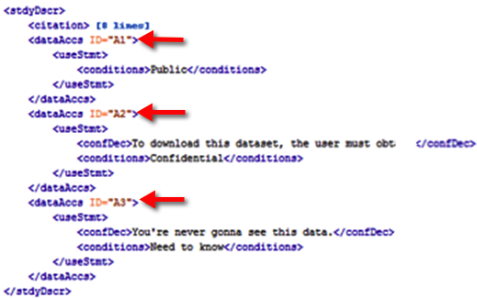
Expressing cloaking rules

Slide 14
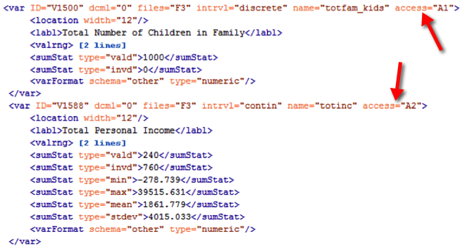
Variable level

Slide 15
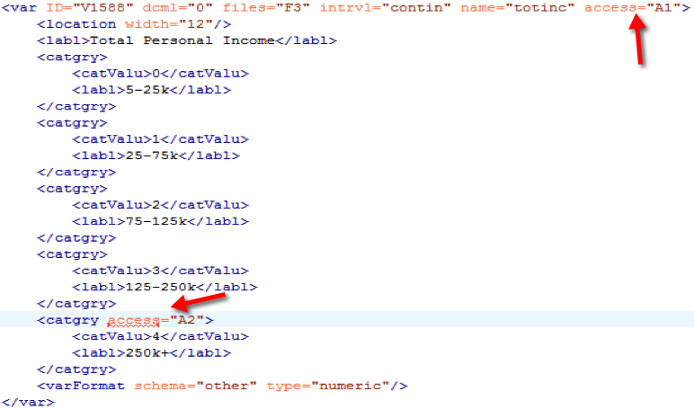
Value level

Slide 16
Dataset relations <RelStdy>
DDI
DDI
DDI
DDI
DDI
DDI

